Slide 1
NMSS Smart – School Management System
Solving communication and efficiency gaps in schools
Presented by Team NMSS
Members:
Prasidha Subedi
Rishav Gautam
Suyog Devkota

Slide 2

Problem Statement:
Communication Breakdowns
Frequent miscommunication between teachers, students, and parents leading to confusion and missed information.
Manual Administrative Burden
Teachers and staff spend excessive time creating timetables and managing routine tasks by hand.
Inefficient Time Management
Valuable classroom time is lost daily due to cumbersome and traditional attendance-taking methods.
Outdated Grading Processes
Complex and slow grading systems hinder timely feedback and accurate record-keeping for student performance.

Slide 3






Introducing NMSS Smart
NMSS Smart is a single, integrated software solution designed to revolutionize school operations.
Instant Notice Board
Automated Timetable
Real-time updates and announcements.
Effortless schedule creation and management.
Streamlined Grading
Digital Attendance
Efficient, consistent, and transparent assessment.
Quick, accurate, and paperless tracking.

Slide 4
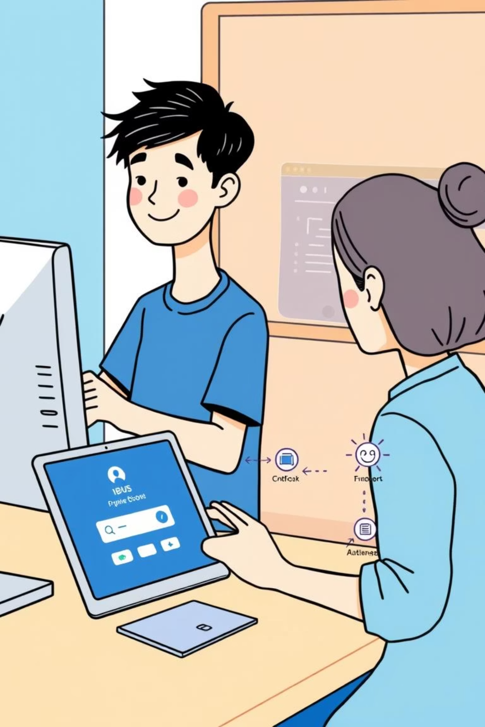



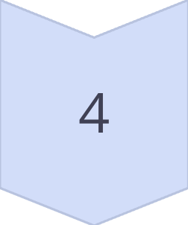
How NMSS Smart Transforms Daily Tasks
Experience seamless integration and efficiency with our intuitive workflow.
Login to a Unified Dashboard
All functionalities accessible from one central, user-friendly interface.
Select Your Desired Feature
Navigate effortlessly to modules like attendance, notices, or grading.
Execute with a Single Click
Perform complex tasks quickly and easily, minimizing manual input.
Achieve Time Savings & Accuracy
Drastically reduce administrative overhead and enhance data precision.

Slide 5


Impact: Before & After NMSS Smart
Witness the tangible benefits of a smarter, more connected school environment.
Before
After
Slow, fragmented communication
Instant, clear communication
Hours spent on manual admin tasks
Automated administrative processes
Less time for actual teaching
More dedicated teaching time
Detached teacher-student interactions
Enhanced teacher-student connection

Slide 6
Thank You!!!
NMSS Smart: Innovating for a brighter academic future.
Team NMSS | IT FEST 2025 NMSS.

